Slide 1
Landing Pages
7 Most important things to consider

Slide 2
What is a Landing Page
Primary purpose is to convert a visitor to a customer
Most important things to consider when creating a Landing Page
Strong call to action
Have an objective and be specific
A clean organised design
Strong call to action
Grab their attention
Create a trustworthy identity
Strong call to action
Optimise for mobile
Perform A/B testing
Check out our guide to landing pages which helps integrate your FR complaint wording

Slide 3
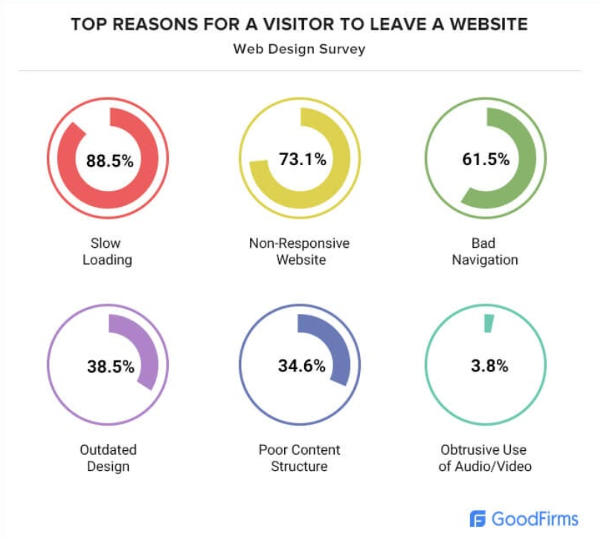

Slide 4
Have an Objective and Be Specific
Consider the key objective that will drive the motive of your landing page
What is the end goal of this page?
What’s the primary action you want a visitor to take from this page?

Slide 5
A Clean, Organized Design
Consider the look, feel, and overall structure of the landing page design
Design changes everything
It should be clean, organized, and easy to understand
HubSpot found that 90% of people left a website because it was badly designed
Great contributing factors to the design. Use high-resolution images/videos that will enhance how your visitors interact with the page
Use an easy-to-read font with plenty of white space. This helps visitors focus on what’s more important which will gear them towards taking action
Keep to a simple layout and mimimize clutter
Use photos and videos

Slide 6
Grab their Attention
The average human attention span today is less than three seconds, and you have 50 milliseconds to make a good first impression
Why should a visitor stay on your page longer, let alone go all the way to take action?
While you keep your landing page clear and concise, you also want to make it appealing enough to keep visitors around
Great design contributes to this but so does great copy too
A perfect blend of copy and design can grab your visitor’s attention and further persuade them to take action

Slide 7
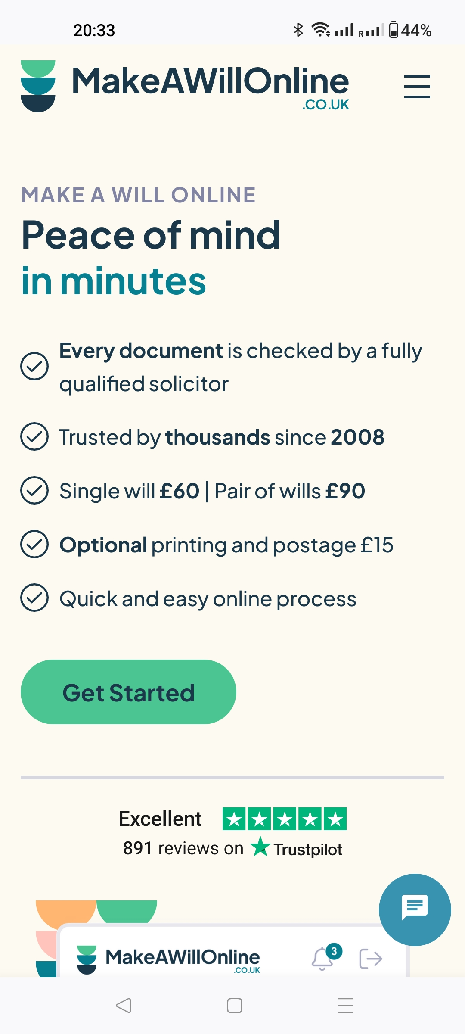
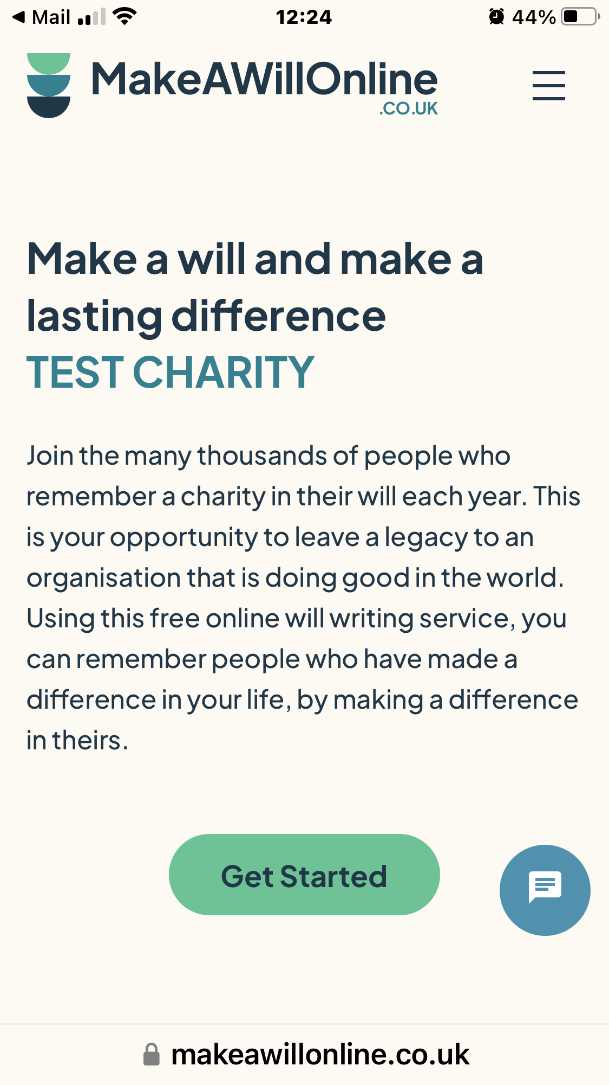
Optimize for Mobile
According to Statista, mobile devices (excluding tablets) generated 54.8 percent of global website traffic in the first quarter of 2021
Your visitors must find it easy to navigate your landing page on a mobile device, as this can double your conversion rate
Ensure that it is fast loading and ultra clickable on any mobile device

Slide 8
Create a Trustworthy Identity
A landing page should not only show your products or services but also depict how reliable your brand is
This should include making use of testimonials and trusted badges to assure potential customers of your brand’s credibility
While creating your landing page, include all the trust signals that show your brand as a trustworthy identity and those of your service providers too

Slide 9
Have a Clear Call-to-action
Every landing page should have a call to action (CTA) that tells visitors the action to take next
Cancer Research UK
You can create a flow that leads every visitor directly to the action you want them to take
RNLI - Royal National Lifeboat Institution - Saving Lives at Sea
Use captivating and clickable CTA buttons that encourage visitors to take any action in line with the objective of your landing page
Save the Children UK | International Children's Charity
The CTA could be to download your GiWs guide or go ahead and make a Will
The Largest Animal Welfare Charity in the UK | RSPCA

Slide 10
Perform A/B testing
Now that you have created your landing page
Test CTAs & buttons
Ensure that it is working perfectly. This is where A/B testing comes in
Test graphics & headings
Helps you collect useful data on how visitors interact with the page
Plus navigation links

